Slide 1

Web security
Leeds Beckett
Z. Cliffe Schreuders
This work by Z. Cliffe Schreuders at Leeds Beckett University
is licensed under a Creative Commons Attribution-ShareAlike 3.0 Unported License.
Redback by Ryan Wick

Slide 2

Web security
As time has gone on, more and more infrastructure has moved to Web-based technologies
Web sites / Web apps are very popular
Often they are bespoke / customised for organisations
Often based on various frameworks and content management systems (CMS)
Web apps have particular kinds of security pitfalls, and have become targets of specialised attacks and assessments
Web Sparklers by Ingrid Taylar

Slide 3
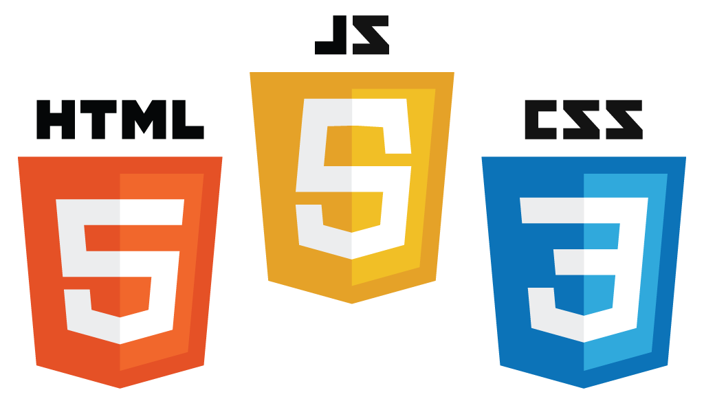
Web basics
Three core technologies make up web pages, as they are displayed client side:
  HTML
  CSS
  Javascript

Slide 4

HTML
Hypertext Markup Language (HTML) is the markup language that defines the content of web pages
html_code:<!DOCTYPE html>
<html>
<head>
<title>This is a title</title>
</head>
<body>
<h1>This is a heading</h1>
<p>Hello world!</p>
</body>
</html>

Slide 5

CSS
Cascading Style Sheets (CSS) defines the presentation of (typically) HTML content
Inline:
css_code:<h1 style="color:red;">Red heading</h1>
Separate style:
css_code:<style>
h1 {color: red;}
</style>

Slide 6

Javascript (JS)
Javascript makes web pages interactive
All modern web browsers contain a Javascript engine, based on the ECMAScript specification
JS is a weakly and dynamically typed programming language
Can execute statements in strings at run-time
JS can modify the environment/DOM...

Slide 7
JS can alter the Website
https://jsfiddle.net/tmhaezfo/4/

Slide 8

Document Object Model (DOM)
HTML document internally modelled and accessed as a tree structure
Modifying the DOM alters the website that is rendered
JavaScript can add, change, and remove DOM elements and attributes (and CSS styles)
DOM-model by Birger Eriksson

Slide 9
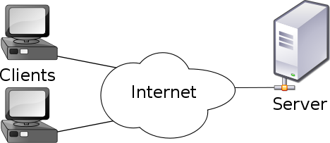
Web architecture
Client/server
In the clear (port 80, http://)
Encrypted via PKI (port 443, https://)

Slide 10
Web architecture
Hypertext Transfer Protocol (HTTP) is a request-response protocol
Application layer (on top of TCP)
Client (user agent, eg. web browser) connects to server
Client makes request
  GET /index.html HTTP/1.1
  Host: www.example.com
Server responds...

Slide 11
Web architecture
Server responds:
  HTTP/1.1 200 OK
  Date: Mon, 23 May 2005 22:38:34 GMT
  Server: Apache/1.3.3.7 (Unix) (Red-Hat/Linux)
  Last-Modified: Wed, 08 Jan 2003 23:11:55 GMT
  ETag: "3f80f-1b6-3e1cb03b"
  Content-Type: text/html; charset=UTF-8
  Content-Length: 138
  Accept-Ranges: bytes
  Connection: close
  <html>
  <head><title>An Example Page</title></head>
  <body>Hello World, this is a very simple HTML document.</body>
  </html>
https://en.wikipedia.org/wiki/Hypertext_Transfer_Protocol

Slide 12
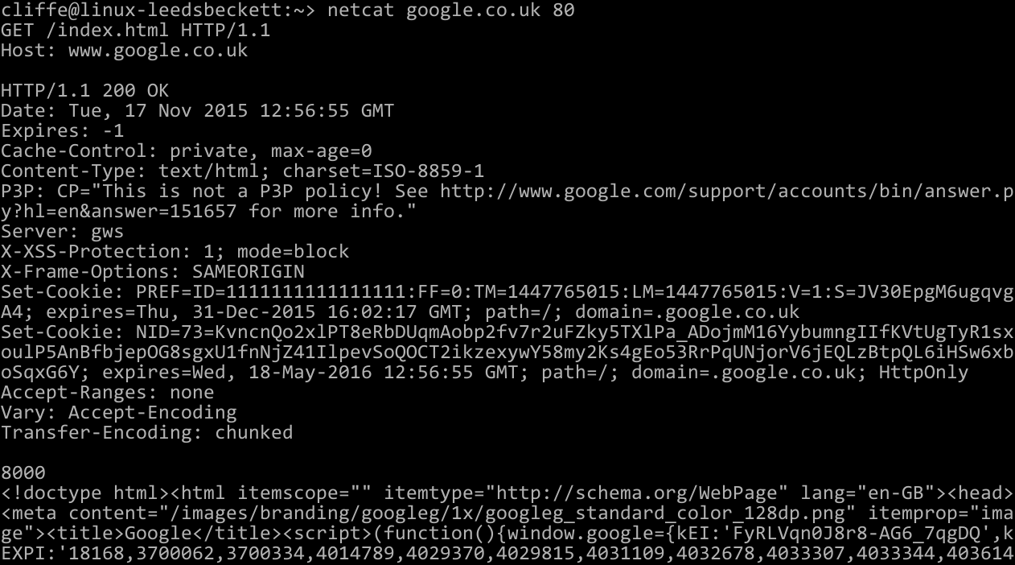
Web architecture

Slide 13
Web architecture
Originally the Web was made up of static HTML pages
Web 2.0: interactive websites
Code on server side (PHP, Java, etc)
Code on client side (Javascript, Flash, etc)
Databases are used to store and retrieve data
  Typically server side via SQL
  HTML5 makes it possible to store on the client

Slide 14
Javascript (JS) frameworks
JavaScript libraries, such as jQuery add extra features and ways of coding websites
Frameworks such as Angular, React, and Vue.js change the way web apps are developed and drive more logic to the client side (such as GUI/Widget based)
Single page webapps rely heavily on JS frameworks

Slide 15
Ajax
“Asynchronous JavaScript And XML”
Enables web pages to change dynamically without reloading the entire page
Typically JS is used to make an XMLHttpRequest
The resulting response is typically JSON or XML data, which JS receives and then updates the DOM

Slide 16
Javascript security
JS can modify the environment/DOM
Can only access web resources; not files on the local system, except through user interaction
Same-origin policy: scripts from one Web site do not have access to data from other sites
Lots can go wrong

Slide 17
Content Management Systems (CMS)
CMS are server-side
A framework for building websites
Wordpress (29% of the Web), Joomla, Drupal, SiteFinity
  Most have been written in PHP
Designed to enable non-technical people to update content
Extendable
CMS and extensions can have vulnerabilities

Slide 18
WPScan
Wordpress and it’s extensions have included critical security vulnerabilities
WPScan is a WordPress vulnerability scanner
Tests for misconfigurations and vulnerable versions

Slide 19
Web services
In addition to web sites / apps, web services are used for machine-to-machine interactions
  For example, an interface used to query an online database, which is called by mobile apps and also other websites or software

Slide 20
Web services: REST
One of the most common kinds of interfaces are RESTful APIs (based on Representational State Transfer)
  Basically make individual requests to a service via standard HTTP methods (GET, PUT, POST, DELETE)
  Typically content of messages is JSON or XML

Slide 21
Web vulnerabilities
Vulnerabilities in frameworks and CMS
Vulnerabilities in bespoke code are common
Misplaced trust in the client, server, or users
Browser/sandbox implementation errors
There are types of security mistakes that are commonly found in websites...

Slide 22
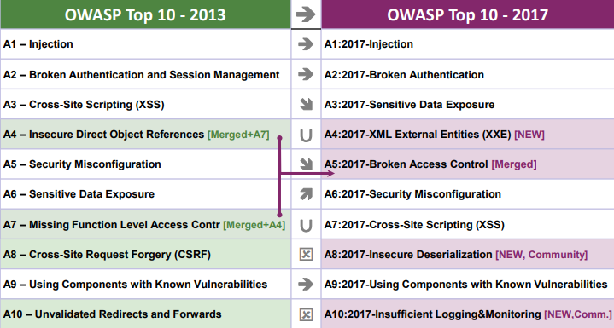
Types of Web vulnerabilities
OWASP Top 10
https://www.owasp.org/images/7/72/OWASP_Top_10-2017_%28en%29.pdf.pdf

Slide 23

Web proxies
Web proxies enable security testing to tamper with the behaviour of clients and servers
  Burp suite
  OWASP ZAP

Slide 24
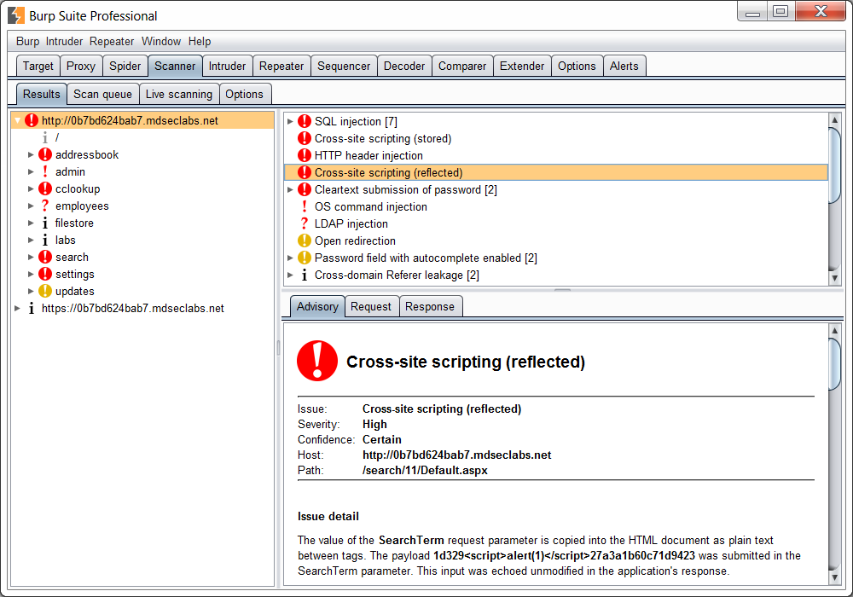
Web vulnerability scanners
Many network vulnerability scanners (including Nessus and Nexpose) have Web scanning features
Specialist tools also exist for various kinds of website testing (manual and automated):
  Burp suite
  OWASP ZAP
  w3af (web application attack and audit framework)
  Nikto

Slide 25

Crawling spiders
Many tools crawl a site to download a copy of web pages and content
  Typically configurable: depth, max pages, etc
May identify versions of frameworks, interesting content, etc
web-side ( #cc ) by marfis75

Slide 26
Finding vulnerable Web apps
Automated scans may find obvious issues, but manual testing may be required to find less obvious flaws
Because detecting coding flaws often involves interacting with the server with malicious code, there is a high risk of some impact on servers (vs other kinds of network scanning)
Metasploit Pro and Nexpose both have web scanning features; MSP has more offensive/exploitation capabilities and delivers a payload

Slide 27
Conclusion
Web security is of ever-growing importance
Many technologies involved: HTTP/S, HTML, CSS, JS, CMS, PHP, Java, REST, ...
Automated tools exist to scan for obvious issues
More complex issues typically require more sophisticated approaches to testing
Awareness of security issues in websites, and testing using web proxies

